Slide 1
LiveIn Sri sai Constructions
Together Towards Tomorrow

Slide 2
LOGO Home About Us Services Projects Enquiry Gallery Clients Contact Us
Sanction 1. Ongoing
Home loan 2. Completed
Site analysis
Architects and Interiors
Constructions
Vasthu Plans
Products (Bricks/Blocks etc)
When we click on home button, movable pictures with the below captions will come
A construction for every imagination – Suitable picture needs to be incorporated
Engineering your dream – Suitable picture
Concept to create – Suitable picture
Cementing relationships – Suitable picture
Building an experience - Suitable picture

Slide 3
LOGO Home About Us Services Projects Enquiry Gallery Clients Contact Us
Sanction 1. Ongoing
Home loan 2. Completed
Site Analysis
Architects and Interiors
Constructions
Vasthu Plans
Products (Bricks/Blocks/cement etc)
When we click on About us, it will have options like
Company profile,
Partners,
Vision and Mission

Slide 4
Company profile
Sri Sai constructions established in the year 2011 is providing value-added construction services to our esteemed customers creating a successful partnership with them throughout the construction process and beyond. We specialize in small to large scale constructions by adopting new age construction technologies. Sri Sai Constructions is offering construction services in terms of site analysis, feasibility studies, preliminary design studies, obtaining permits / sanctions, Loans, Architecture, engineering, interior designing etc. We have been handling variety of projects creating industrial, residential, office, recreational and commercial spaces also provide expansion, renovation and refurbishment of existing facilities.

Slide 5
Sri sai constructions work on 4 basic elements Quality Integrity Safety Teamwork
Quality: Our aim is to continuously exceed the expectations of our client to dliver quality construction. Our team members verify all features of work
Integrity:
Maintaining strong ethics, valuing honesty and cementing our reputation for transparency and accountability
Safety
Proactive safety planning helps us to provide a safe working environment for everyone working on the project, people visiting the job site.
Teamwork
To become an industry leader it is important for us to emcourage team work in order to solve any construction challenges and to achieve results

Slide 6
Partners:(Names) 1. 2. 3. 4.
Vision:
Transform the way people perceive 'Quality'
Mission :
To cement your requirement to satisfaction with quality & Compassion. No shortcuts to quality

Slide 7
When we click on servives, it will have subtitles like
Sanction
Construction of the house involves considerable preparation. The preparation stage involves getting all the documents related to the site, identifying the contractor, submission of documents for a loan, approval from the concerned authorities like Bruhat Bengaluru Mahanagara Palike (BBMP), Bangalore Water Sewerage and Sanitary Board (BWSSB) and Bangalore Electricity Company (BESCOM). We bring in a facility to help our clients on easy sanctioning from the concerned authorities

Slide 8
Home loans (Additional page with picture of currency and a bank executive)
We bring in a facility to ensure convenience for our customers to interact with financial institutions and banks to avail housing loans. We help our clients with easy processing of loans by closely working with them during the documentation process required by financial institutions and banks like HDFC Limited, HDFC Bank, Corporation Bank, State Bank Of India, ICICI Limited and Axis Bank, DHFL, etc in all our projects.

Slide 9
When we click on Architecture and interior design, the page will open with the architectural pictures, drawings and sublines and brief description and services we offer
LiveIn Architects
is a multi-disciplinary firm specialising in projects ranging from Individual Residences, Apartments, Row Housing, Religious & Educational Institutions, Hotels, Cinemas etc.
Designing dreams needs a lot of creativity, and creativity is not based on age, experience and gender. LiveIn Architectural and Interior Design team combine design with technology. We take up execution & Design consultation (Design + supervision) or complete Turnkey based on the need. We believe creativity is unlimited…so we love to experiment and create unique designs. Constant application of best practices and newer technology keeps us ahead of time .We work to design evolved spaces that are balanced with air,light and space. Making your living spaces comfortable and suit your tastes. Personal attention to detail in every step of the project development pushes us to reach newer heights in the services we provide, across planning,designing, supervising and coordinating all aspects of the developments.

Slide 10
Continued…..
SERVICES OFFERED
MASTER PLANNING
Concept and master plan design
Developing building programs &
feasibility studies
Preparing site plan strategies
Integrating existing buildings with new construction
STRUCTURAL ENGINEERING
Advanced analysis including seismic analysis, structural dynamics, vibration analysis
Wind studies and tension structures

Slide 11
Continued….. ARCHITECTURE + INTERIOR DESIGN
Innovative solutions and inspiring design
Creative & efficient planning
Application of cumulative experience from various projects
Responding to site and client needs
Committed to satisfying each clients' unique needs
Presentation of detailed CAD drawings
Presentation of material schemes and 3 Dimensional views
Presentation of initial schemes and concepts
Provide skilled workforce of carpenters, painters, false ceiling, civil works, electrical, tiling and plumbing technicians
Coordinating work among fire alarm, fire suppression and access control contractors
Coordinating work among heating, ventilation and air-conditioning contractors
Coordinating work among lighting contractors

Slide 12
Continued…..
ELECTRICAL + MECHANICAL DESIGN + ENERGY MANAGEMENT
Electrical systems design
Lighting and power systems Designs
Fire, alarm, security and safety systems
HVAC & ventilation systems
Process piping systems

Slide 13
When we click on constructions, sai construction page will come with the details below
Sri Sai Constructions
specializes in small to large scale constructions by adopting new age construction technologies.
Construction is a civil contracting company, excelling in construction to achieve enhanced customer satisfaction, delivering quality finished product. We are resolved to complete all our assignments in time creating a safe working environment. We are dedicated to make improvements in every vertical of civil construction. Every service we render carries with it the quality. As a part of our extended services we are even present to guide and support our customers in all their purchase decisions. This is done following on the budgetary provisions of our customers and we strongly believe that they need our supportive services when it is about purchasing items for floor, wall, furnishing, plumbing and electrical requirements.

Slide 14
Continued…..
Services we offer
Civil Engineering
Electrical Engineering
HVAC
Developing building programs & feasibility studies
Preparing site plan strategies
Integrating existing buildings with new construction

Slide 15
Vasthu Plans
Vastu is not a religion it's a science of setting the things correctly and balances the five elements that is Earth, fire, water, space, and air to have the maximum benefit out of life. Vastushastra is based on various energies that come from atmosphere like solar energy from sun, cosmic energy, lunar energy, thermal energy, magnetic energy, light energy, wind energy. These energies can be balanced to enhance peace, prosperity and success. We are the pioneers in the arena of Vastu Shastra services and your one-stop site for the best Information.

Slide 16
Products
We believe in offering the best cement concrete and steel, In terms of cement we bank on quality cement products of India Cement, Zuari Cements, L & T, ACC, Coromandel and Birla. Steel is one of the most important components in construction. Steel is used to add strength and durability to the constructed structure as it is used in foundation, i-beams, pillar or ceiling etc. Since, SV Constructions is aware of the importance of steel, it relies on quality steel from lead companies like: Tata, Indus Steel & Suguna.

Slide 17
Projects : (A new page with completed and ongoing project details with picture if possible

Slide 18
Clients: A new page with clients we worked and working

Slide 19
Gallery: Completed Project pictures

Slide 20
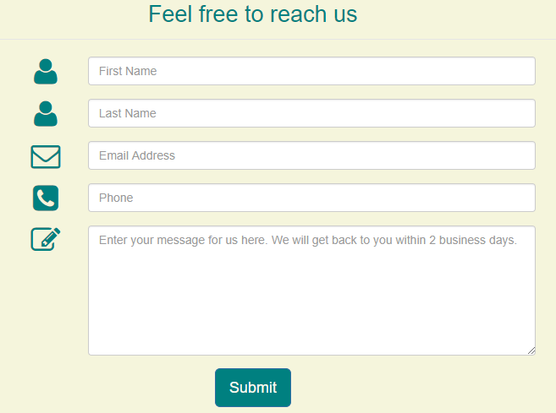
Enquiry

Slide 21
Contact us
Office address
Email
Phone number
location

